Slide 1
CITY CONNECT CAR LOAN PROCESSING SYSTEMS

Slide 2

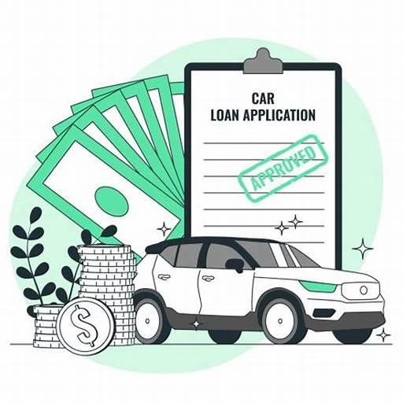
CONTENTS
INTRODUCTION
REQUIREMENT ANALYSIS
FLOW DIAGRAMS
PHASES

Slide 3
INTRODUCTION

Slide 4
The tasks involve loading applicant and car loan details into the bank's database, updating repayment details from collection agencies and CITY CONNECT Bank, and generating daily and weekly reports on car loan repayments. Additionally, there is a task for cleaning up and loading applicant, car loan, and payment data into the history database.

Slide 5
REQUIREMENT ANALYSIS

Slide 6
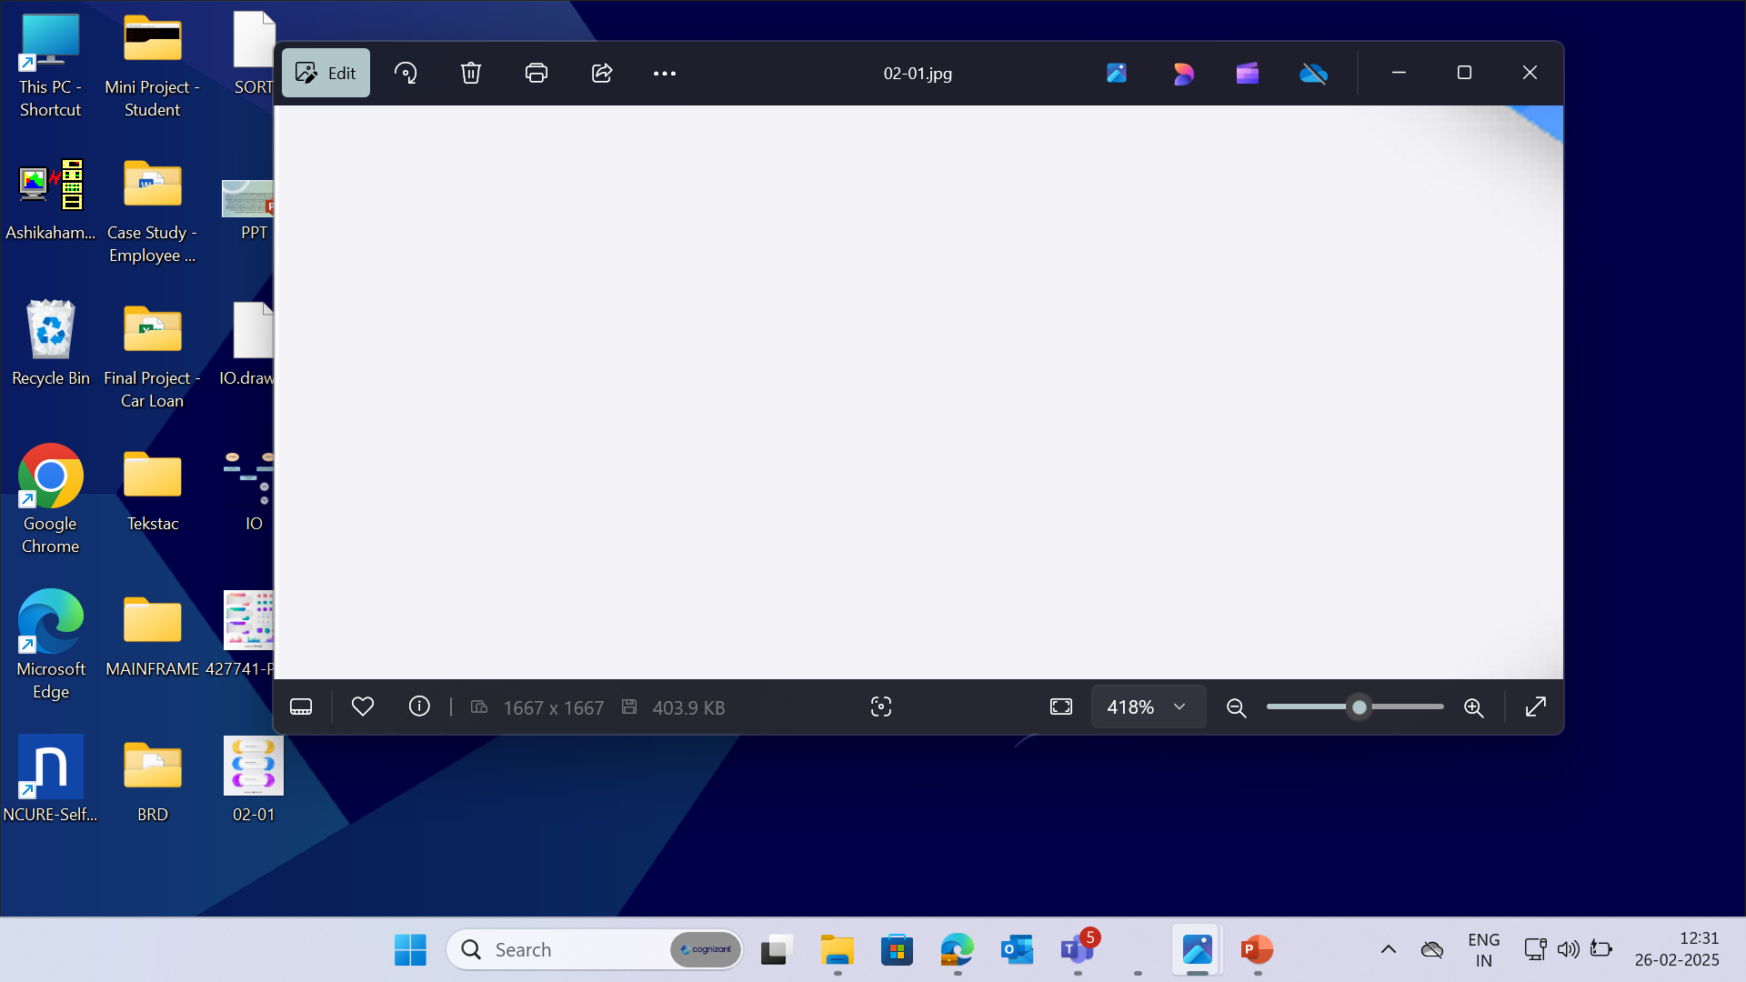


PCOMM Emulator - to access the Mainframe environment.
Pcom Emulator
SOFTWARE
REQUIREMENTS
DB2 - used for storing
the data in format.
TSO, JCL – to run and execute programs.
COBOL – to access inputs and perform required computations.
6
© 2025–2027 Cognizant | Private

Slide 7
CONTEXT FLOW DIAGRAM

Slide 8
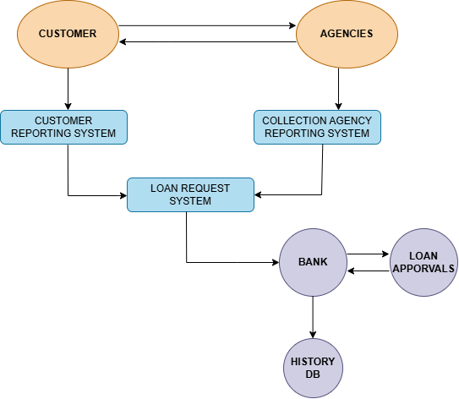
The context flow diagram shows loading applicant and car loan details, updating repayment information, generating repayment reports and cleaning/loading data into the history database.

Slide 9
DATA FLOW DIAGRAM

Slide 10
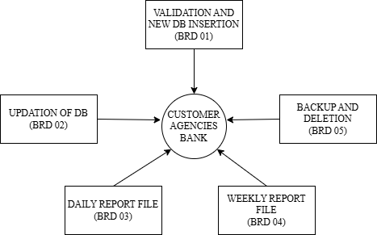
The Data Flow Diagram (DFD) visually represents the flow of data within a system, illustrating how data is processed.

Slide 11
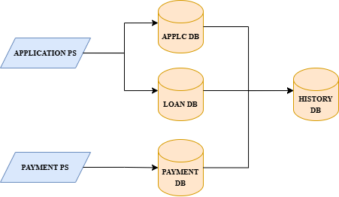
The below Flow Diagram depicts the overall process done in Car Loan Processing systems.

Slide 12
BUSINESS REQUIREMENT OVERIEW

Slide 13
BRD 05 - HUSSAIN LOKHANDWALA
(2372539)

Slide 14
BRD : 05 - Data Cleanup and History Database Update
The process involves taking a backup of the Master Loan VSAM file, identifying and moving closed car loans to the history database, and deleting obsolete loan records from various databases. It includes sorting payment records, consolidating duplicate entries, and updating the loan closure dates for short-term car loans. Finally, it involves extracting details of applicants with specific loan tenure and closure dates, and generating reports in the standard format with page breaks.

Slide 15
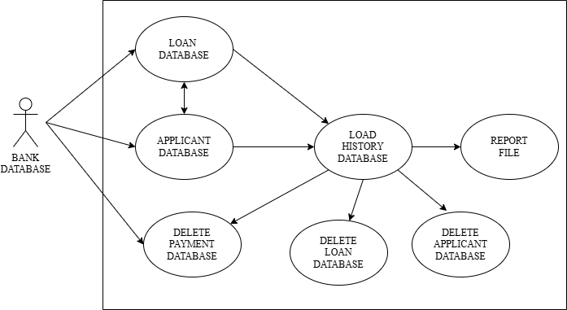
BRD : 05 – Use Case Diagram

Slide 16
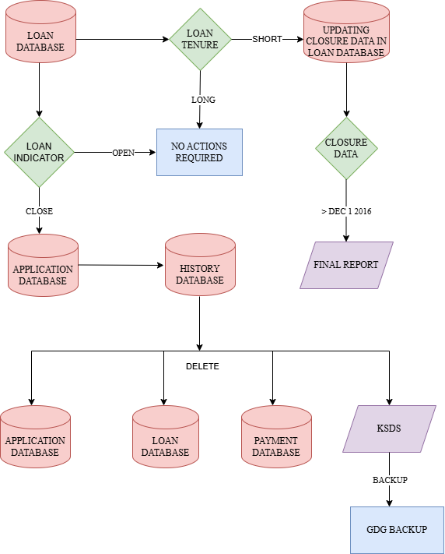
BRD : 05 – Flow Chart

Slide 17
PROCESS FLOW
Backing Up Data
The process begins by taking a backup of the Master Loan VSAM file in a Generation Data Group (GDG) file, ensuring data security and recoverability with a limit of 10 versions.
2. Identifying and Moving Closed Loans
Next, the loan database is swept to identify closed car loans, which are then moved to the history database. Corresponding entries in the applicant, loan, and payment databases, as well as the Master Loan VSAM file, are deleted.
3. Updating History Database
For closed loans, if all car loans of an applicant are obsolete, their details along with loan and payment records are deleted and moved to the history database. If only some loans are obsolete, only those specific records are moved.

Slide 18
4. Sorting Payment Records
After deletion, the payment file records are sorted in descending order based on Applicant ID. Duplicate records are consolidated by summing the amount paid, ensuring accurate and streamlined data.
5. Generating Reports
Details of applicants with short-term loan tenure and closure dates greater than Dec 1, 2016, are extracted. Reports are generated in the standard format with a maximum of 8 lines per page, ensuring organized and clear presentation of data.

Slide 19
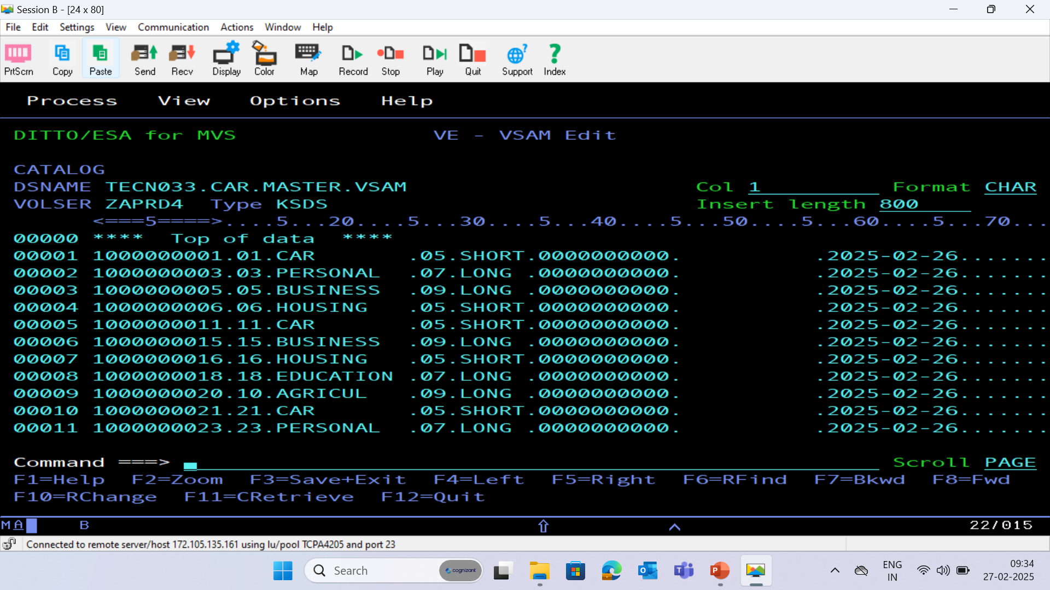
BRD 05 VSAM CLUSTER

Slide 20
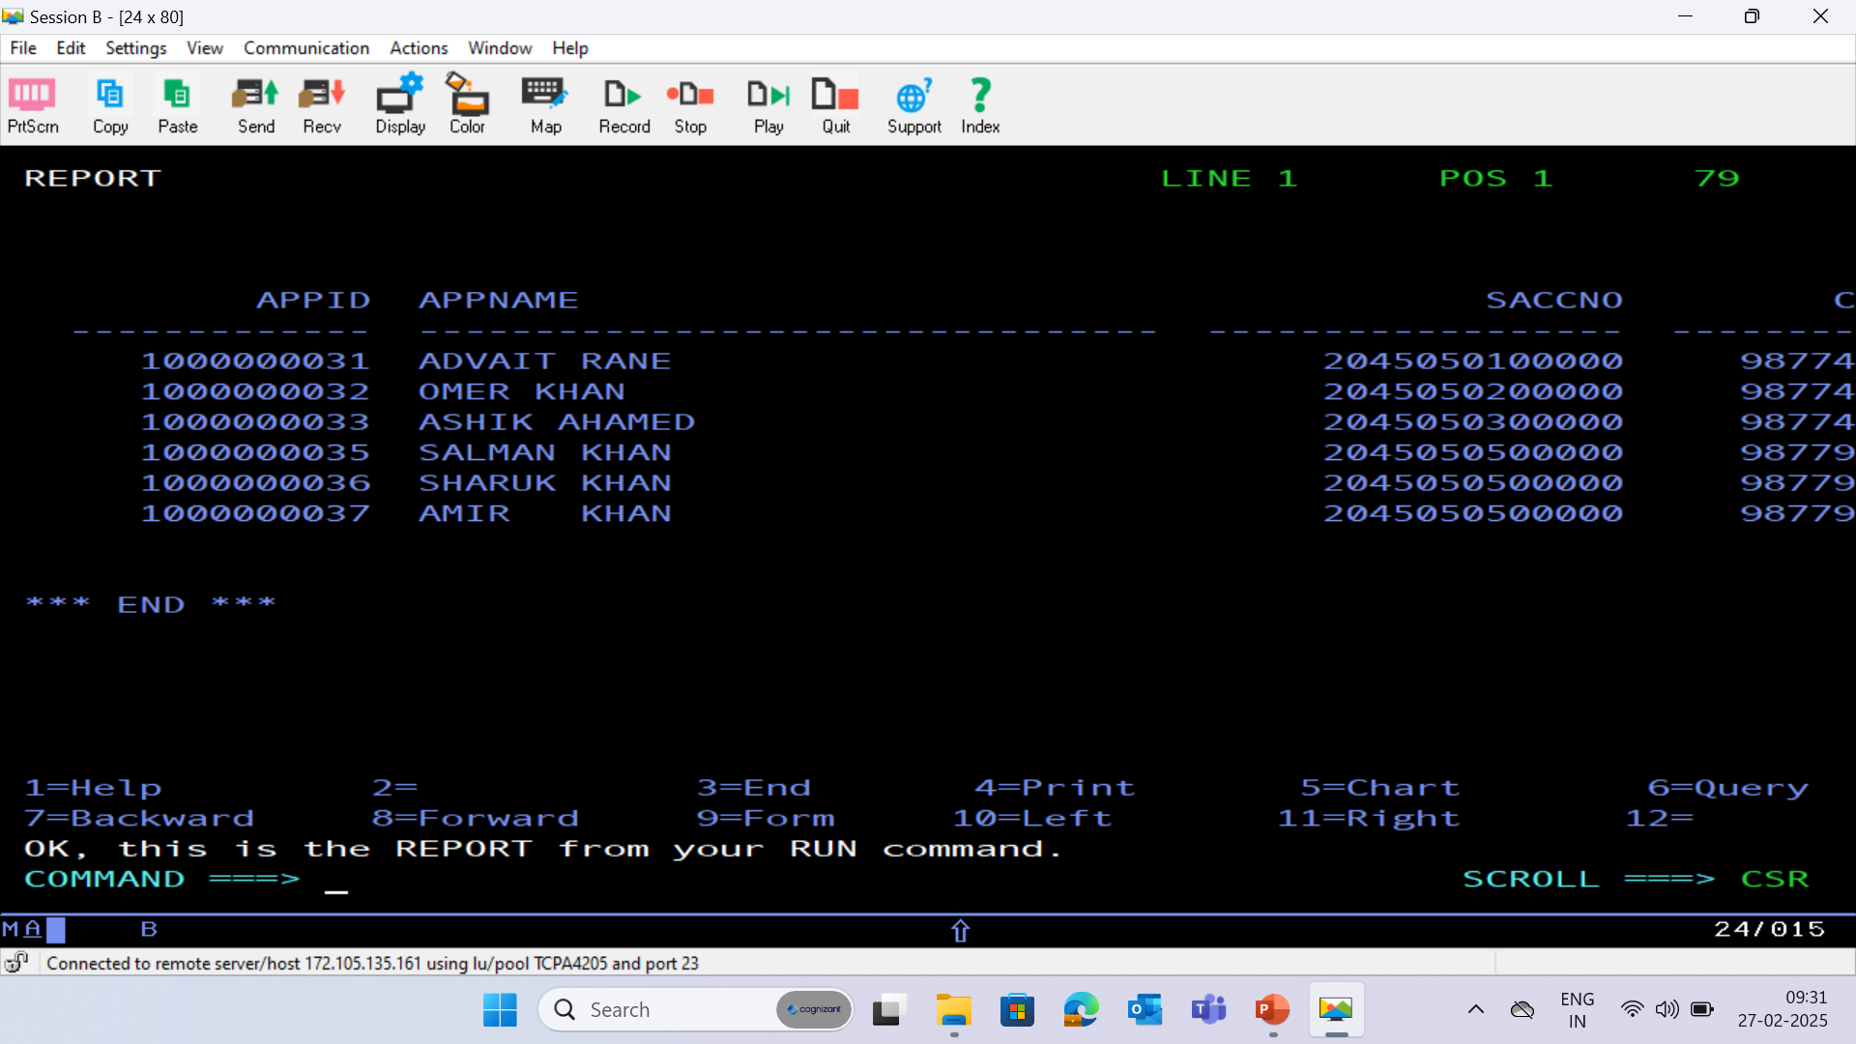
HISTORY DATABASE - (HISTORY)

Slide 21
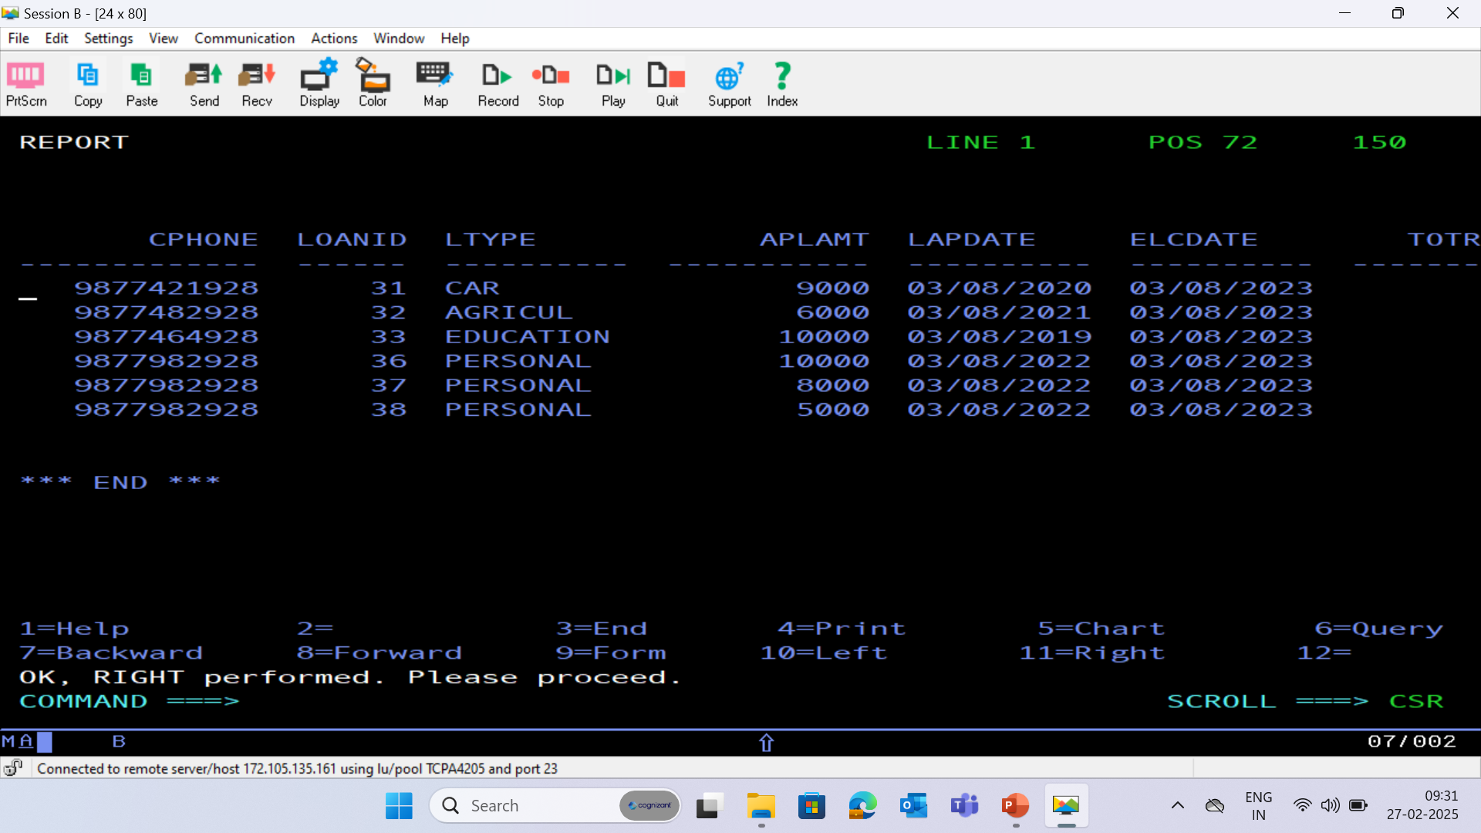

Slide 22
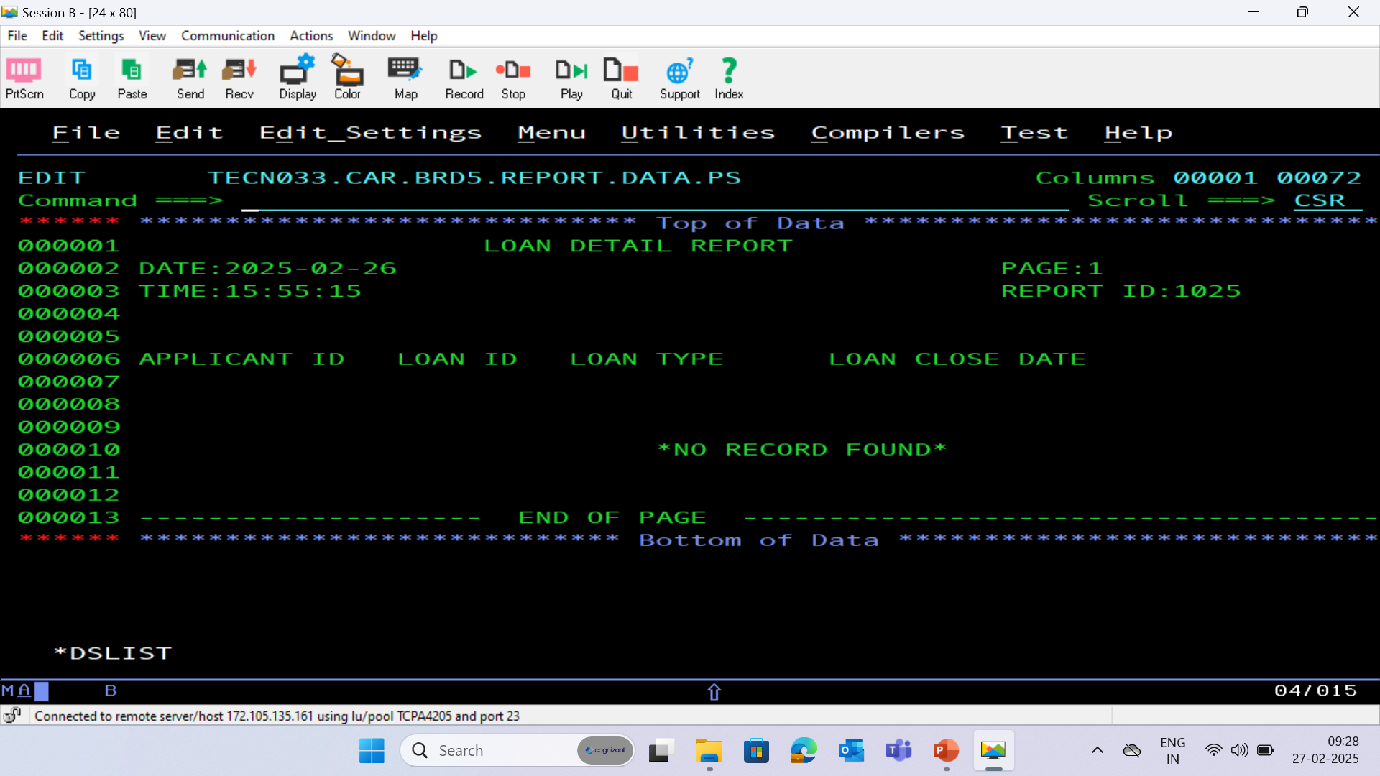
BRD 05 REPORT PS FILE

Slide 23
THANK YOU

Slide 24
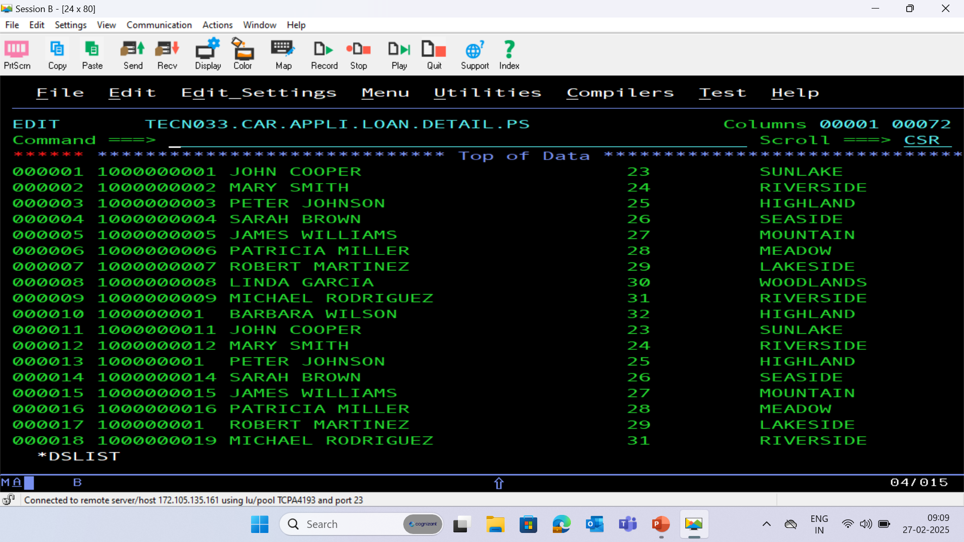
APPLICATION PS FILE

Slide 25
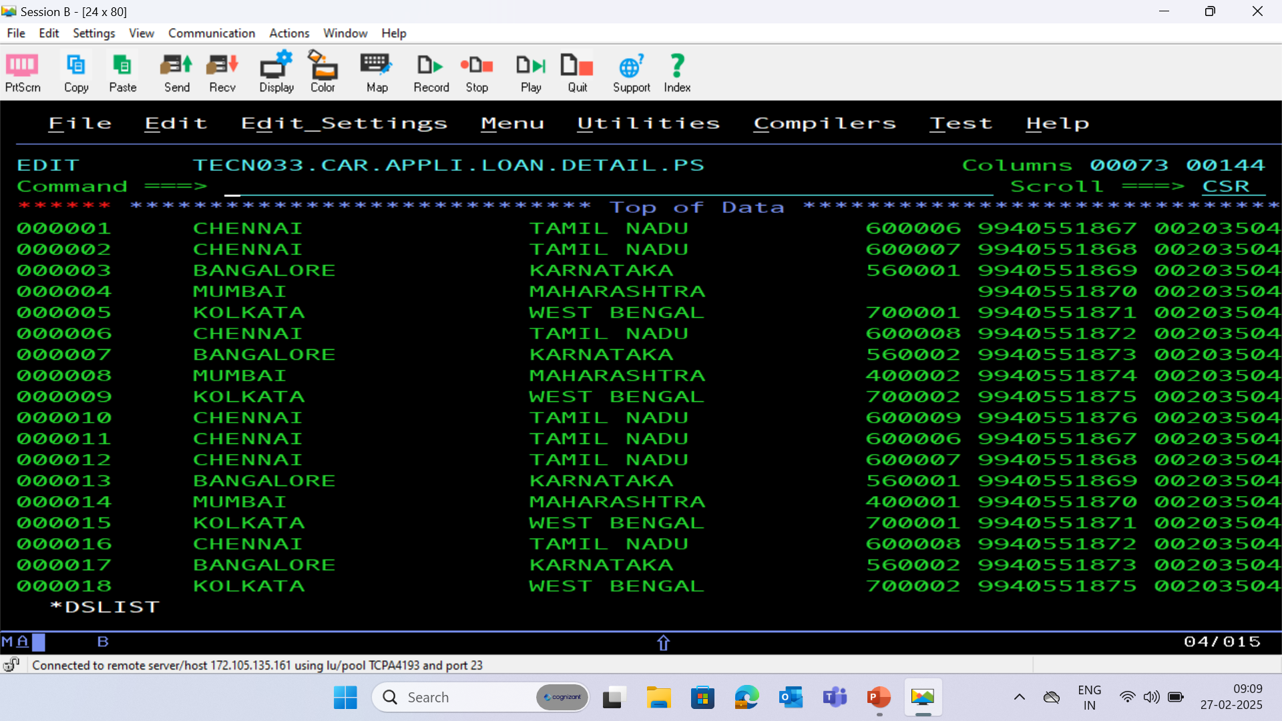

Slide 26
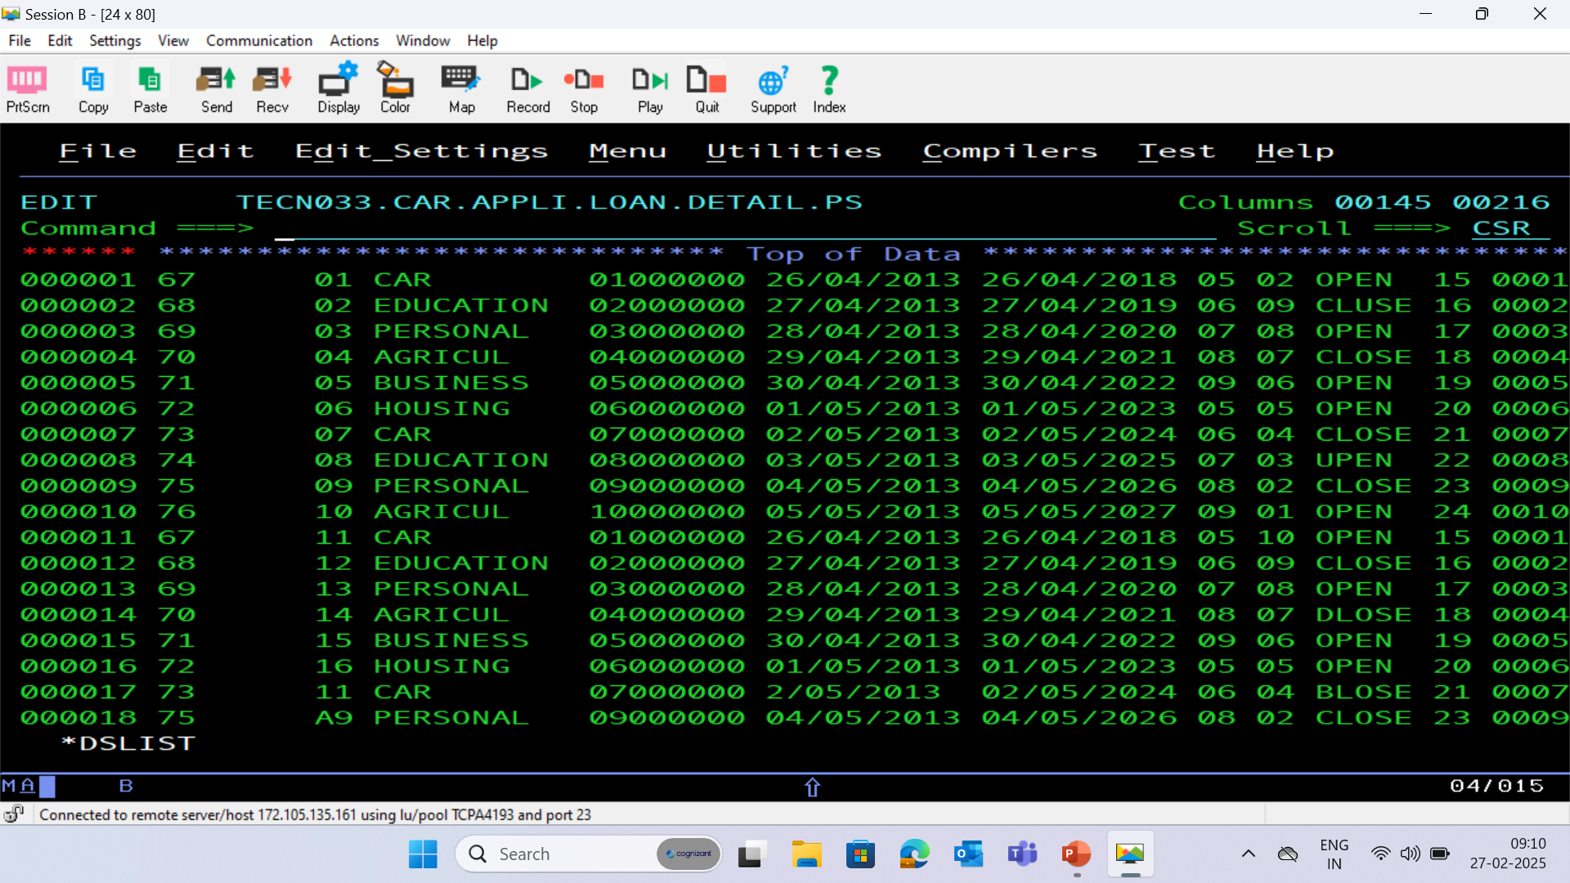

Slide 27
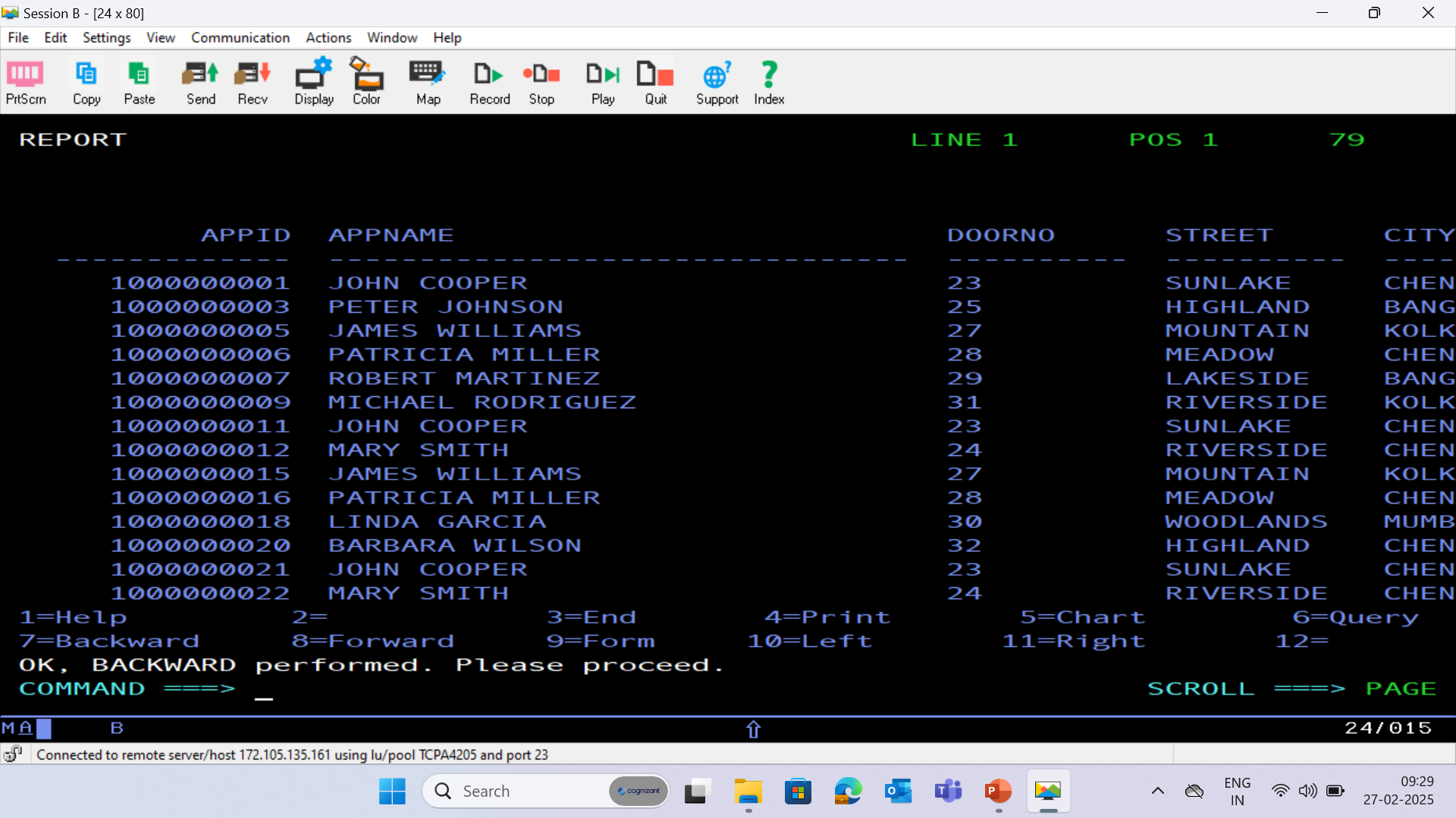
APPLICATION DATABASE - (APPLC)

Slide 28
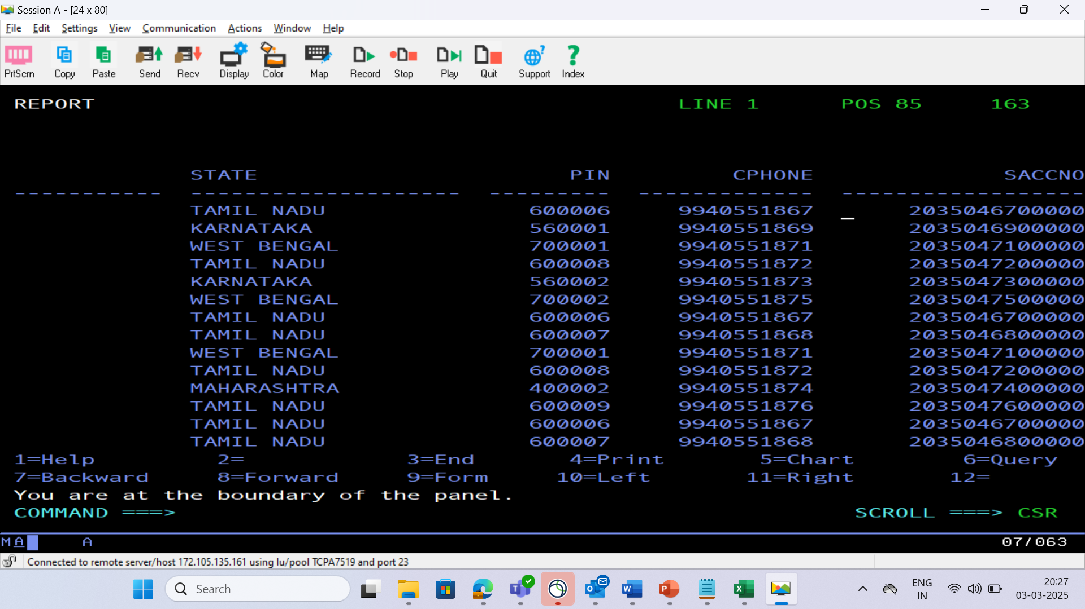

Slide 29
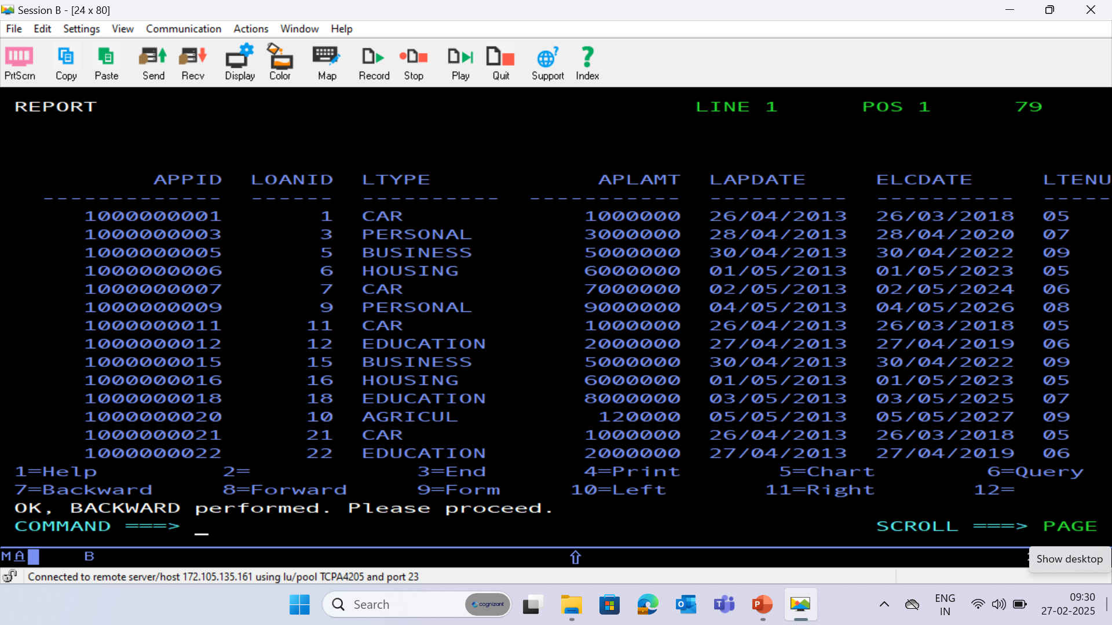
LOAN DATABASE - (LOAN)

Slide 30
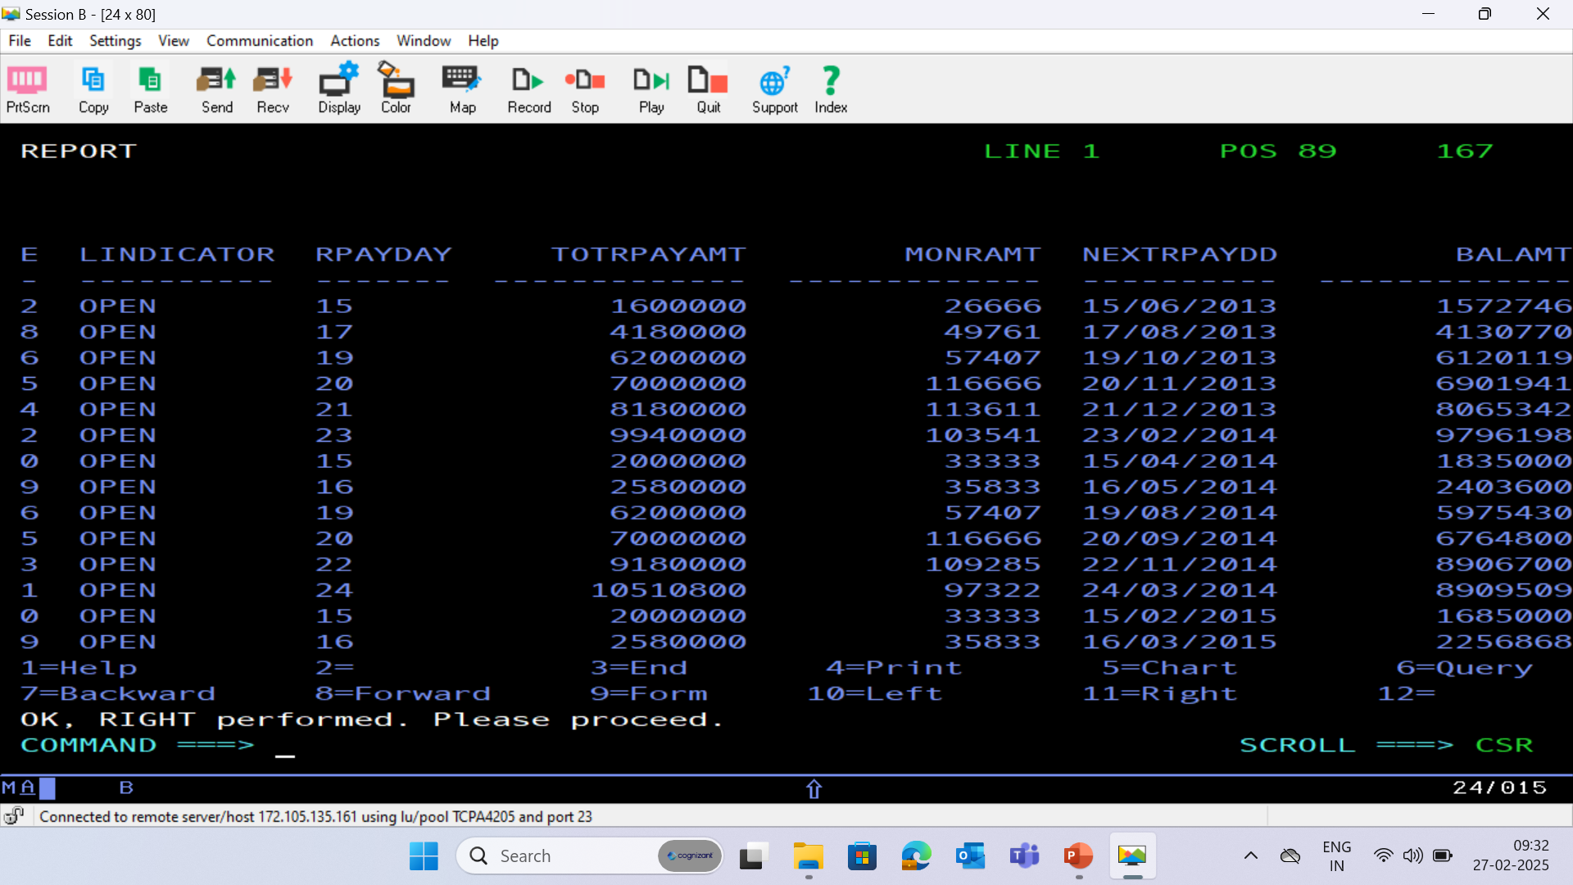

Slide 31
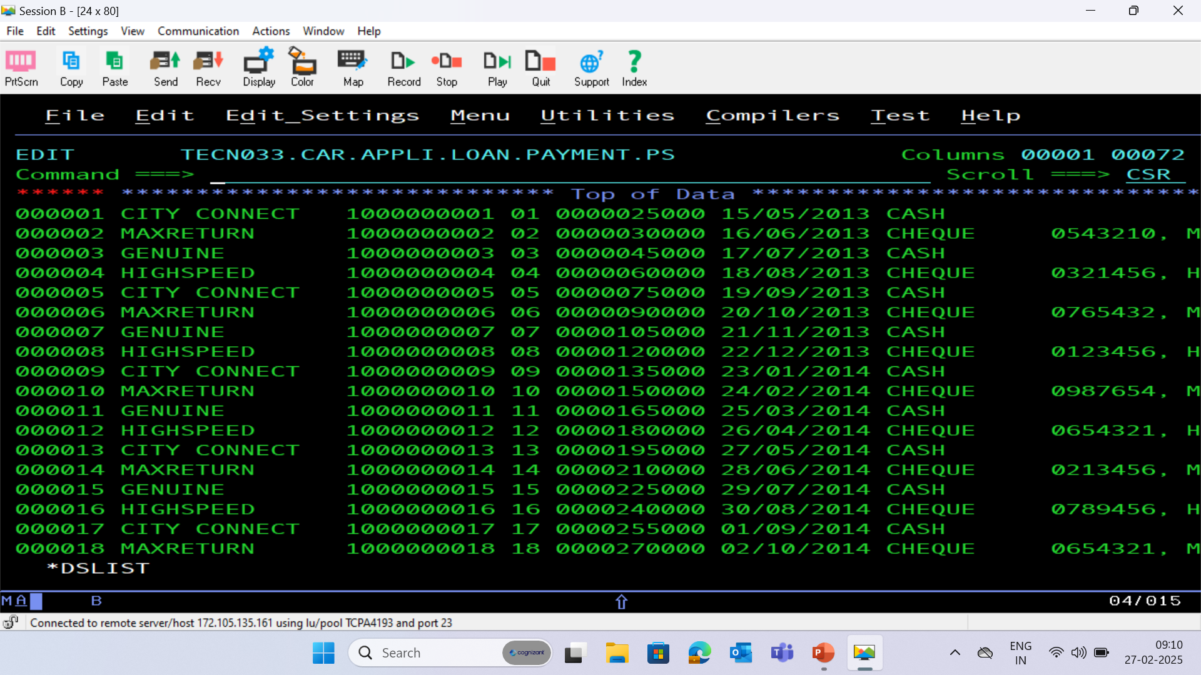
PAYMENT PS FILE

Slide 32
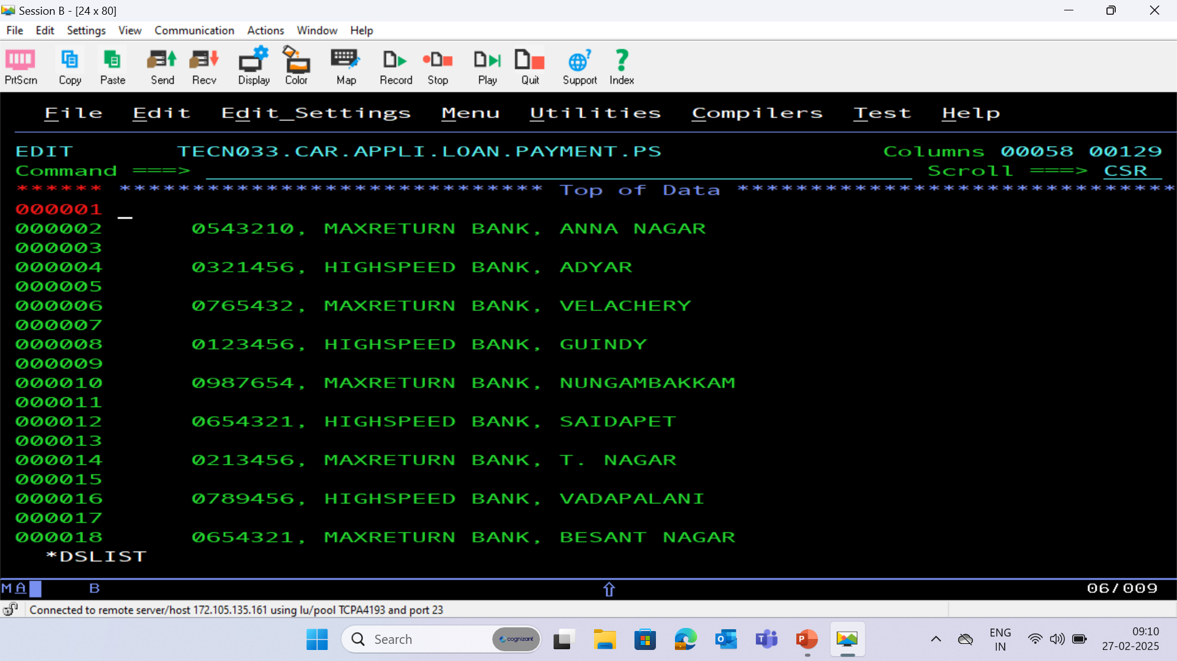

Slide 33
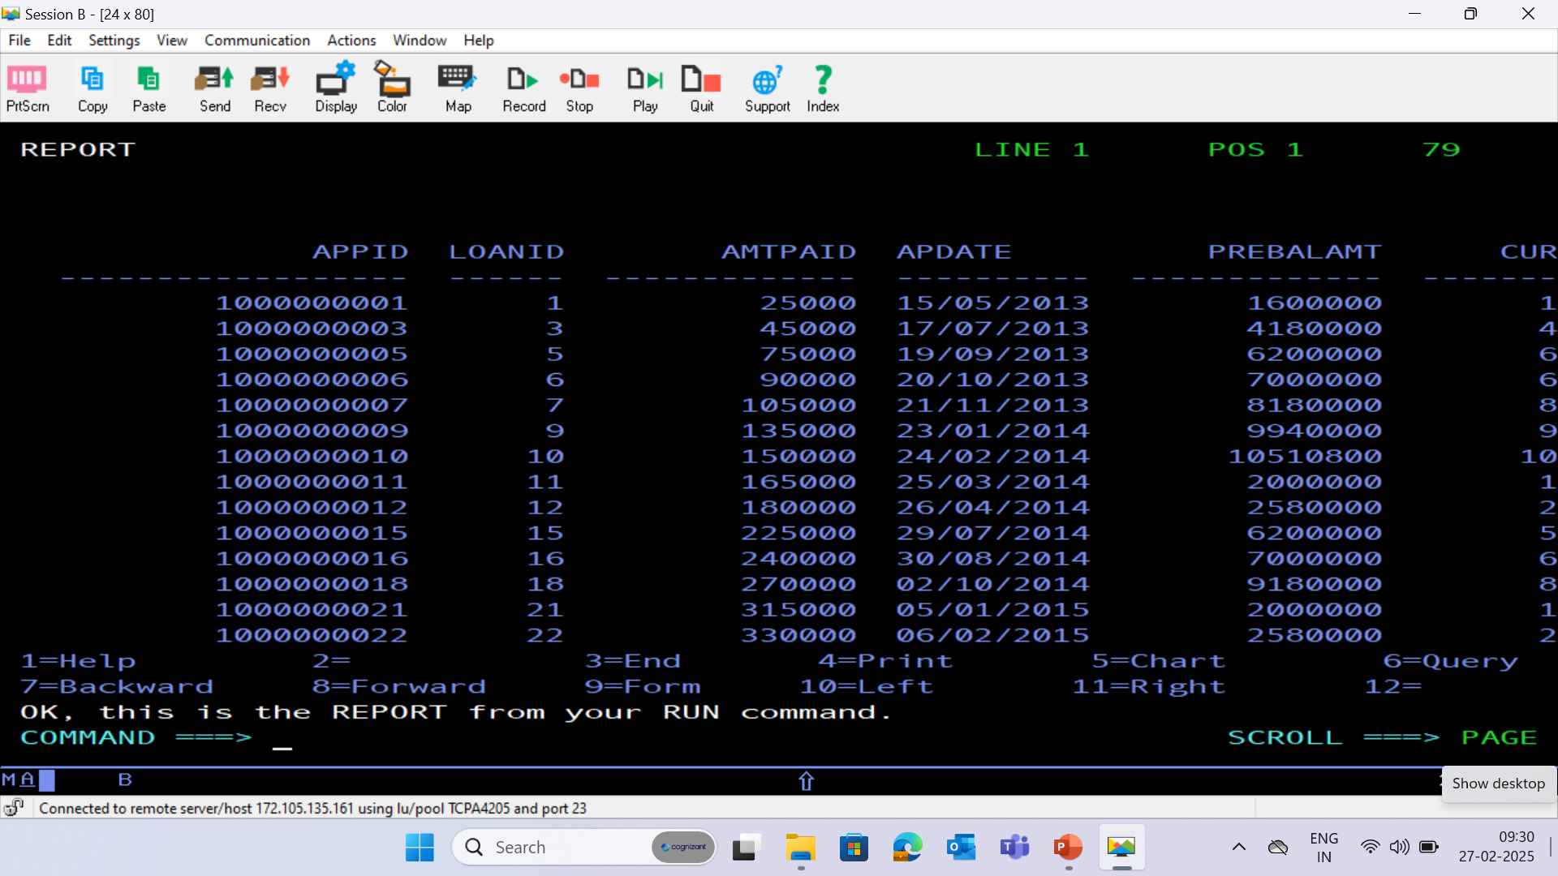
PAYMENT DATABASE - (PAYMENT)

Slide 34
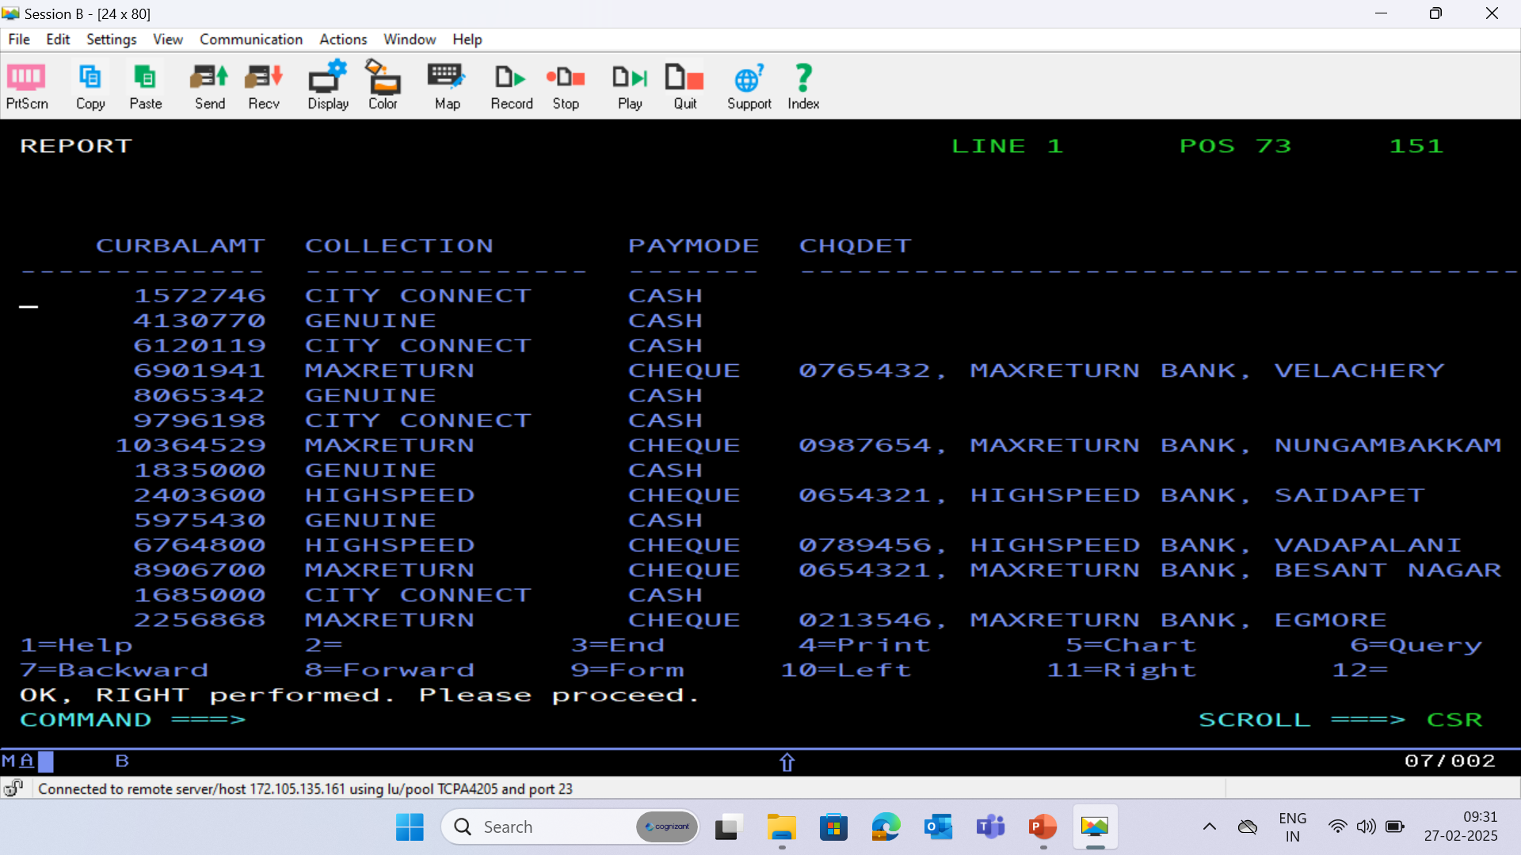

Slide 35
HISTORY DATABASE - (HISTORY)

